Slide 1
Relational Database
What is RDBMS ?
List of RDBMS

Slide 2
RDBMS : Definition
A relational database is a digital database based on the relational model of data, as proposed by E. F. Codd in 1970. A software system used to maintain relational databases is a relational database management system (RDBMS). Many relational database systems have an option of using the SQL (Structured Query Language) for querying and maintaining the database.

Slide 3
List of rdbms
MySQL
PostgreSQL
SQL SERVER

Slide 4
MySQL:
is an open-source relational database management system (RDBMS).
MySQL has stand-alone clients that allow users to interact directly with a MySQL database using SQL, but more often MySQL is used with other programs to implement applications that need relational database capability. MySQL is a component of the LAMP web application software stack (and others), which is an acronym for Linux, Apache, MySQL, Perl/PHP/Python. MySQL is used by many database-driven web applications, including Drupal, Joomla, phpBB, and WordPress. MySQL is also used by many popular websites, including Facebook Flickr, MediaWiki, Twitter,and YouTube.

Slide 5
PostgreSQL :
is a powerful, open source object-relational database system with over 30 years of active development that has earned it a strong reputation for reliability, feature robustness, and performance.
Postgres Advantages over MySQL:
Postgres is an object-relational database, while MySQL is a purely relational database. This means that Postgres includes features like table inheritance and function overloading, which can be important to certain applications. Postgres also adheres more closely to SQL standards.
Postgres handles concurrency better than MySQL for multiple reasons:
Postgres implements Multiversion Concurrency Control (MVCC) without read locks Postgres supports parallel query plans that can use multiple CPUs/cores Postgres can create indexes in a non-blocking way (through the CREATE INDEX CONCURRENTLY syntax), and it can create partial indexes (for example, if you have a model with soft deletes, you can create an index that ignores records marked as deleted) Postgres is known for protecting data integrity at the transaction level. This makes it less vulnerable to data corruption.

Slide 6
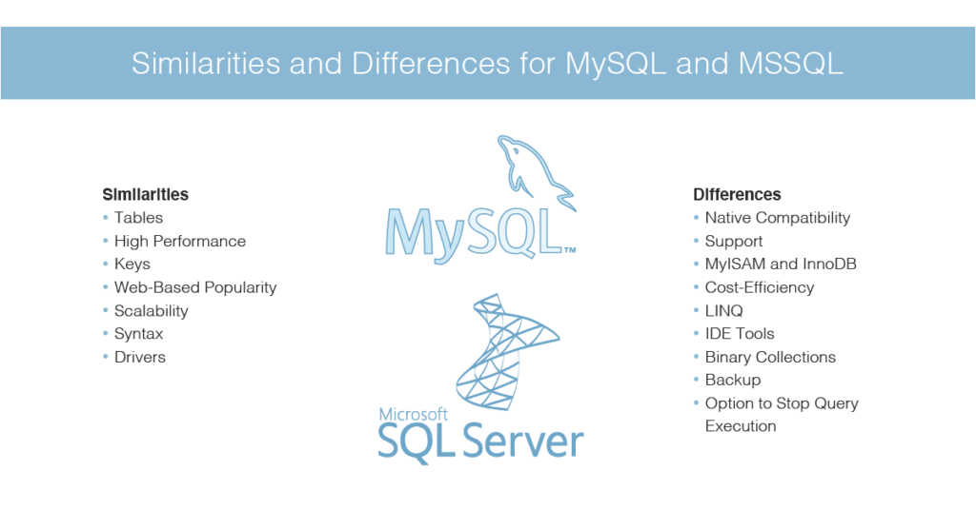
SQL SERVER:
Microsoft SQL Server is a relational database management system developed by Microsoft. As a database server, it is a software product with the primary function of storing and retrieving data as requested by other software applications—which may run either on the same computer or on another computer across a network (including the Internet). Microsoft markets at least a dozen different editions of Microsoft SQL Server, aimed at different audiences and for workloads ranging from small single-machine applications to large Internet-facing applications with many concurrent users.

Slide 7
Difference Between SQL Server and PostgreSQL
Both of these being types of SQL a question may arise about what is the difference between both SQL Server vs PostgreSQL. Microsoft SQL server is a database management and analysis system which is mainly used for e-commerce, line of business and different data warehousing solutions. PostgreSQL, on the other hand, is an advanced object-relational database management system which provides support to the extended subset of SQL standards including different transactions, foreign keys, subqueries, triggers, and different user-defined types and functions.

